Slide 1
GEORGIA BIOMASS
Georgia Dept of Economic Development
Costas Simoglou and Loren Heyns
with Freedom Energy Tech CEO, Nat Mundy

Slide 2
HOW CAN WE MAKE INFORMED DECISIONS ABOUT BIOMASS OPTIONS?
Georgia is the first state to partner with the US EPA to include environmental outcomes in supply chain modeling.
Positive Outcomes Value Added
Quality Jobs
Clean Air Clean Water Clean Energy
Local Suppliers Green Materials
Inclusive Design
Improves Health Creates Beauty
Impacts to Avoid Acid Rain (ACID) Freshwater Ecotoxicity (ETOX) Water Eutrophication (EUTR) Global Climate Change (GCC) Respiratory Effects (HRSP) Toxic to Humans (HTOX) Ozone Depletion (OZON) Smog Formation (SMOG)
Resources Use Energy Use (ENRG) Land Use (LAND) Minerals and Metals (MINE) Water Use (WATR) Waste Management
Food Waste (FOOD) Hazardous Waste (HAZW) Municipal Solid Waste (MSW)
The 10 positive outcomes encompass the 7 petals of the Living Community Challenge.

Slide 3
SUSTAINABLE MATERIALS MANAGEMENT
U.S. Environmentally-Enable Input Output (USEEIO) Model
The U.S. EPA is partnering with Georgia communities to create online tools to evaluate how technological innovation in local industries, utilities and logistics can reduce carbon footprints and protect the environment while creating jobs and new business opportunities.
Who’s using the model…
- 24 universities including the
University of Pennsylvania, Yale, Carnegie Mellon Harvard and the University of Washington - Colorado School of Mines - Alameda County Supply Chain Sustainability - NREL/DOE Bioeconomy Assessment Framework
- EPA’s Sustainable Material Management
Prioritization Tool Suite
Look who’s using USEEIO:
2040 Net Zero Goal Setting

Slide 4
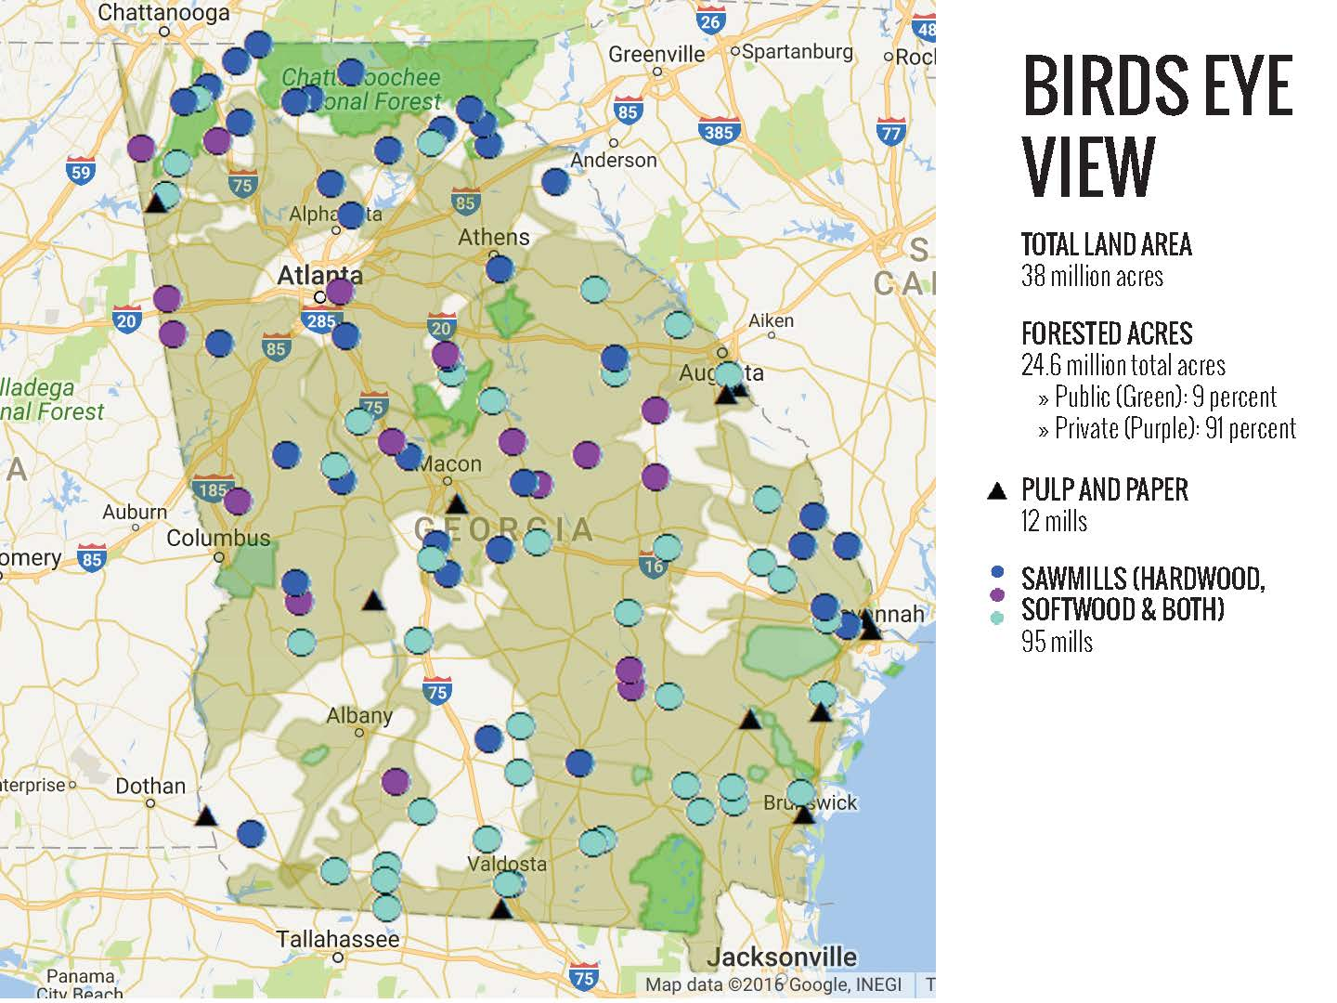
Sustainable Biomass Products and Fuels
GEORGIA FORESTRY INDUSTRY
Georgia has 22.4 million acres of private
timberland, more than any other state. Forestry provides 148,414 direct and indirect jobs and 48% annual growth vs. removals.
Georgia produces 21% of U.S. exports of pulp and
paper, and 26% of U.S. wood pellet exports. Source: Georgia Forestry Assoc.
Notes:
Georgia is consistently ranked as the top forestry state in the nation.

Slide 5
Emerging Market
NET POSITIVE MASS TIMBER
In February 2020 Macy's headquarters announced their
move into Georgia’s first mass timber office building –
T3 West Midtown at Atlantic Station.
While steel and concrete construction release large amounts of carbon into the atmosphere, wood captures
and stores carbon for hundreds of years, after
which it can be recycled or used as fuel.

Slide 6
Innovative Materials
ADVANCED WOOD PRODUCTION
Making cars, trains and planes – FROM SUPERWOOD!
Superwood – Light weight, low cost, stronger than titanium, termite-proof Nanowood - Better insulator than Styrofoam. Purifies salt-water.
Question: How do we use the removed lignin?
InventWood team at the University of Maryland
Notes:
$3.5 Million Grant - https://arpa-e.energy.gov/?q=slick-sheet-project/superstrong-low-cost-wood-lightweight-vehicles Press the block at 100 ºC for a day. The result: a wooden plank one-fifth the thickness, but three times the density of natural wood — and 11.5 times stronger. Previous attempts to densify wood have improved the strength by a factor of about three to four. https://www.nature.com/articles/d41586-018-01600-6

Slide 7
Sustainable Material Flow
NEW PRODUCTS AND CLEAN ENERGY OUTPUT
Poplar trees are members of the willow family and typically live in wetlands or where water is plentiful.

Slide 8
Fast-Growth at Treatment Facilities
Transformative Forestry and Hydrology
Processed lignin and other locally abundant biomass can be used to amend the soil to a depth of one meter.
Trees planted three to five saplings per square meter grow 10x faster in the rich soil as they compete for sunlight.
Fast growing poplar and willow trees within flood plains can be harvested every 5 to 25 years.
Plant oils and bacteria can be used to remove sulfur odors from extracted lignin (Ecosorb)
Higher ground along waterways may be reserved for longer-term growth so more mature tree roots act as a “safety net” to prevent nutrient leaching.
The Sweet Smell of Success - Recycling with Bacteria Graduate student Stephanie Mathews uses soil bacteria to transform black liquor into foam rubber, bottles and fuel.
Notes:
https://www.frontiersin.org/articles/10.3389/fbioe.2015.00072/full https://grad.ncsu.edu/news/2015/07/stephanie-mathews-converting-stinky-paper-waste-into-the-sweet-smell-of-success/

Slide 9
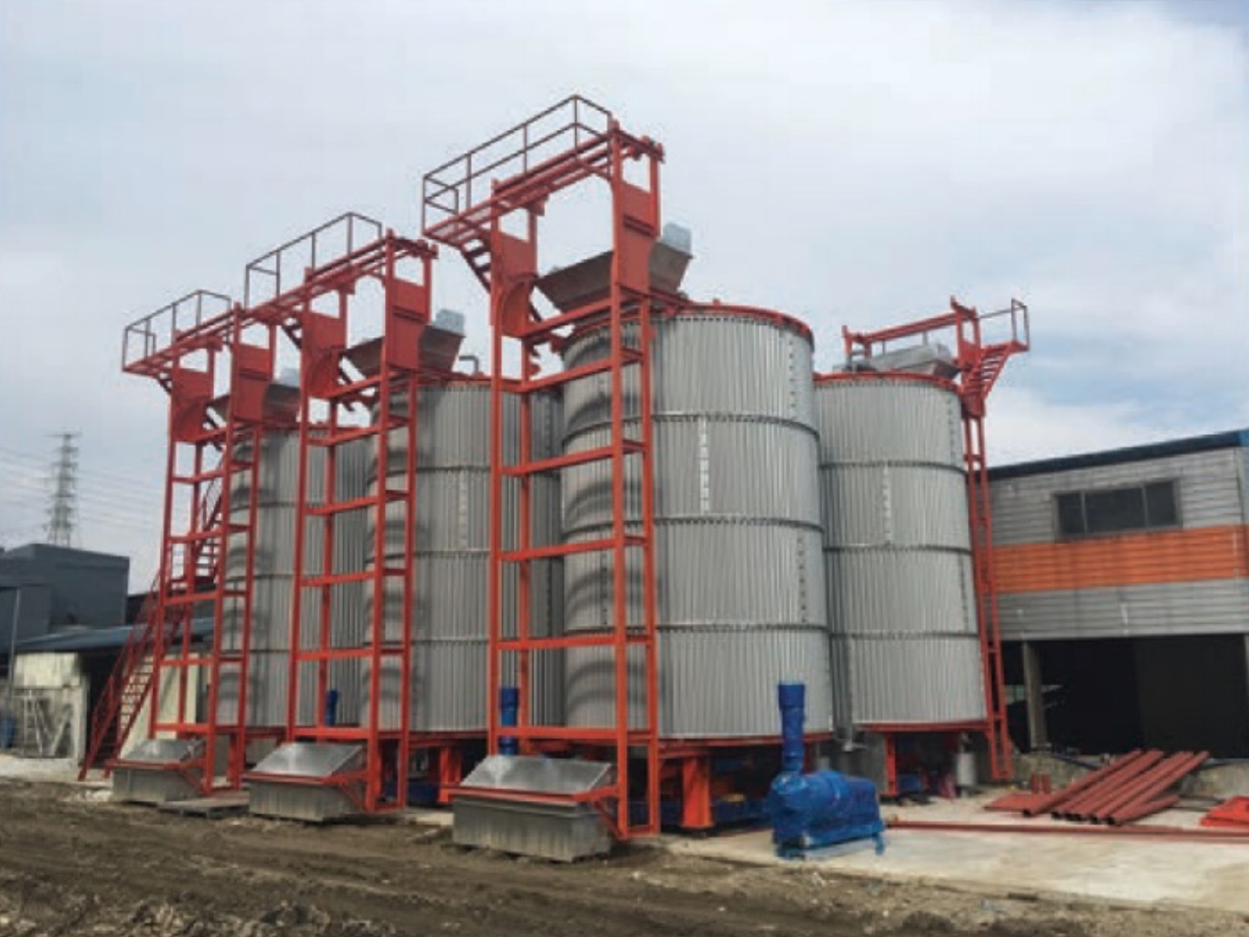
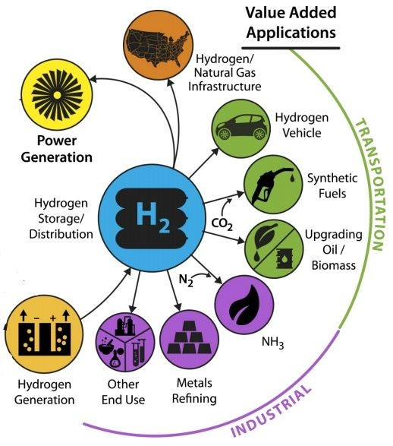
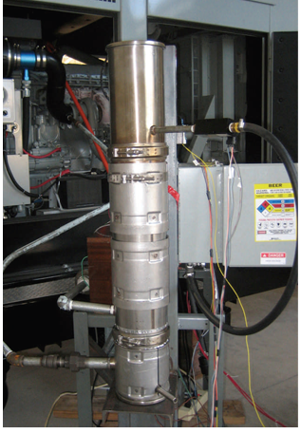
Accelerated Aerobic Digester Waste biomass and biosolids input. Outputs fertilizer for biofuel crops and forestry, materials for gasification.
ENERGY FROM BIOMASS RESIDUE
Low Heat Rotary Gasifier uses biomass residue, plastics, municipal solid waste (MSW), landfills, tires and mattresses as fuel.
7-Day Aerobic Digester
Low Heat Gravity Rotary Gasifier (Air-Staged Kiln)
Low Temperature Syngas
Generation (PRISM)
Syngas to Hydrogen, Ethanol and Higher Products

Slide 10
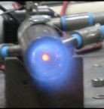
Syngas from biomass using nonthermal plasma with CPOX
A cost-effective method for producing clean hydrogen-rich, process-ready syngas from any carbonaceous feedstock at room temperature. Eliminates the intensive energy requirement while maintaining high conversion efficiency using Catalytic Partial Oxidation (CPOX).
Less than 1% parasitic load. Greater than 98% CO/H2.
60 to 100 watts to operate. Exothermic so room temp natural gas is introduced and a near pure synthesis gas exits at around 800°c.
“PRISM is a viable tool for implementation into small to mid-scale syngas production plants, and full commercial integration with minor adjustments.” - Adam A. Gentile, Springer Handbook of Petroleum Technology Nat Mundy, Freedom Energy Tech CEO
Researchers: Dr. Leslie Bromberg, MIT Michael Carpenter, RTI International
PRISM hybrid plasma/catalysis system ionizes and reforms any vapor phase species with a focus on short to long chain hydrocarbons.
Notes:
Catalytic partial oxidation (CPOX) using a low-energy, nonthermal plasma is capable of nearly perfect conversion of a carbonaceous starting material into clean, homogeneous, hydrogen-rich syngas.
System we ran our testing on…. as you see this system replaces a SMR plant with a footprint for of 3x3 and a fraction of the energy. The system does not require any compression on the front end is exothermic so that room temp natural gas is introduced and a near pure synthesis gas exits at around 800c. The entire system is controlled off of a laptop or phone and can be operated and monitored remotely.

Slide 11
Trucks Driving Hydrogen
2028 NIKOLA FUELING STATIONS
In just two years,
“a small band of believers has turned into a large band of implementers”
- Bosch VP.
8 hydrogen stations in Georgia by 2028. 40+ in California today.
Los Angeles 2020
Notes:
https://nikolamotor.com/hydrogen

Slide 12
GEORGIA INNOVATES
Join our Sustainable Communities Challenge – Post your ideas at model.Georgia.org
Costas Simoglou, Centers for Innovation Energy Director
Loren Heyns, Georgia Programmer Analyst
Nat Mundy, Freedom Energy Tech CEO
404.661.5554 csimoglou@georgia.org
678.468.1000 lheyns@georgia.org
407.925.3300 natmundy@gmail.com

